Slide 1
FREE JAVA INTERVIEW MODULE

Slide 2
Today’s Agenda
Objectives Of The Course
Prerequisites Of The Course
Why you should take this course ?
How this course is structured ?
Course Contents WalkThrough

Slide 3
Objectives
The ONE AND ONLY objective of this course is to prepare
you for Java interview and also what type of questions are
asked in interviews based on Java Profile
Whether you are a fresher or highly experienced professional,
CORE JAVA plays a vital role in any Java/JEE interview.
It is the favourite area in most of the interviews and plays a
crucial role in deciding the outcome of your interview.

Slide 4
Objectives
This course comes directly from Team SCA’s 20+ years
experience of Java programming and lots of interviewing
experience.
We all know that recently most of companies have started
asking questions from Java 8 and so in this course we also teach
you Java 8 features as well as its Interview Question as well.

Slide 5
Prerequisites
Since this course aims at preparing you for the Java Interview so
you must be familiar with JSE i.e. CORE JAVA .
You must have written some code based upon the most basic
Java topics like:
Data Types ,Operators, Control Stmt
Arrays & String
Fundamentals Of Object Oriented Programming
Collections Framework
Exception handling

Slide 6
Why You Should Take This Course?
This course aims at providing you 3 important benefits:
To Target all tricky Interview Question in Java .
To deeply understand all the complex concepts in Java
Most importantly this course will make you CONFIDENT in your INTERVIEW because you will know that you can answer the question more accurately.

Slide 7
Topic Walkthrough
There’s lot we will cover in this course and so it has
been divided into 6 modules:
Java Basics
Arrays & Strings
OOP & Modifiers
Collections
Java 8
Multithreading

Slide 8
Module 1 Java Basics
Platform Independency V/s Portability
The main() Method And It’s Variants
Data Types, Operators & Precedence
instanceOf Operator
Tricky Questions Based On Above Topics

Slide 9
Quiz
Guess The Output :
byte b = 5;
b=-b;
System.out.println(b);
Guess The Output:
byte b = 5;
b+=10;
System.out.println(b);
Output:
Error
Output:
15
Guess The Output:
int a=0;
for(int i=0;i<100;i++)
{
a=a++;
}
System.out.println(a);
Output:
0

Slide 10
Guess The Output: Integer b2=127; Integer b3=127; System.out.println(b2==b3);
Sample Questions We Will Discuss In The Class
Guess The Output:
Integer b2=128;
Integer b3=128;
System.out.println(b2==b3);
Output:
true
Output:
false

Slide 11
Module 2: Arrays And String
Introduction To Array
One Dimensional Array
Creating , Initializing, Accessing
Multi Dimensional Array
Creating , Initializing, Accessing
Tricky Questions Based On Above Topics

Slide 12
Module 2: Arrays And String
Introduction To String & It’s Important Methods
Understanding String Constant Pool
Strings Immutability
Benefits Of Immutability
Comparison With StringBuffer And StringBuilder
Tricky Questions Based On Above Topics

Slide 13
Sample Questions We Will Discuss In The Class
Guess The Output:
int []arr=new int[5];
System.out.println
(arr.getClass().getName());
Guess The Output:
int[]arr={10,20};
int []brr={10,20};
System.out.println
(arr.equals(brr));
Output
[I
Output:
false

Slide 14
Sample Questions We Will Discuss In The Class
Can you answer this:
String s=new String(“Hello”);
How many objects are created in the above code ?
Answer:
2
Very Popular Question:
Why it is not recommended to use Strings for storing passwords ?

Slide 15
Module 3: OOP & Advance OOP
Encapsulation
Abstraction
IS-A RelationShip
HAS-A RelationShip
super(), this() & toString()
Tricky Questions Based On Above Topics

Slide 16
Module 3: OOP & Advance OOP
Polymorphism( Signature , Overloading & Overriding)
Covariant Return Types
Abstract Class
Interface
Packages , Access Modifiers And Non Access Modifiers
Tricky Questions Based On Above Topics

Slide 17
Sample Questions We Will Discuss In The Class
Can we instantiate a class in this way ?:
public class A
{
A a = new A();
}
Answer:
Not possible, Because while instantiating, constructor will be called recursively.

Slide 18
Module 4: Collections
Comparator V/s Comparable
Map , HashMap & TreeMap
Internal Working Of HashMap
Changes In HashMap In Java 8
HashMap V/s Hashtable
Tricky Questions Based On Above Topics

Slide 19
Sample Questions We Will Discuss In The Class
Very Popular Interview Question:
Why it is recommended to use
List list = new ArrayList();
instead of
ArrayList list = new ArrayList();

Slide 20
Module 5: Java 8 Or Modern Java
Why Java 8 Is So Popular ?
New Features Of Java 8
Java 8 Interface Enhancements
Functional Interfaces
Lambda Expressions
The Stream API
Tricky Questions Based On Above Topics

Slide 21
Can you Solve This ?
WAP to calculate sum of nos from 1 t0 100:
Old Style
New Style:
int sum=0;
for(int i=1;i<=100;i++)
sum=sum+i;
System.out.println(“sum is ”+sum);
int sum=IntStream.rangeClosed(1,100).sum();
System.out.println(“sum is ”+sum);

Slide 22
Module 6: Multithreading
What Is MultiThreading And Why We Need It ?
Creating Threads
Thread Life Cycle
Synchronization
Most Popular Interview Questions

Slide 23
Course Schedule
Item | Dscription
Course Duration | Around 40 hrs
Batch Schedule | Saturday & Sunday
Batch Timings | Saturday :10Am Sunday: Afternoon
Class Duration | 1.5 Hours
Next Class | Saturday 18th Sep

Slide 24
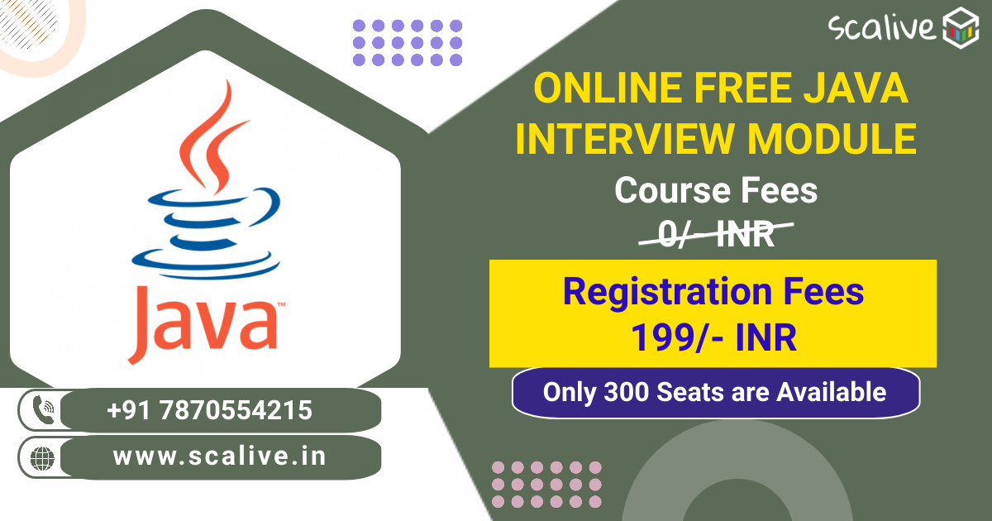
Course Fee-Rs 0

Slide 25
Thank You

